Slide 1
Backup and Recovery
C393: Database Systems

Slide 2
Review

Slide 3
What's a Transaction? (ACID)
We need some guarantees:
Atomicity
Consistency
Isolation
Durability
-- Bank customers: A and B
-- A Venmos B $50
USE bank;
-- Take $50 from A
UPDATE acct SET bal = bal - 50 WHERE acctID = 'A';
-- Pay $50 to B
UPDATE acct SET bal = bal + 50 WHERE acctID = 'B';
Notes:
Imagine we had a database called bank with a table called acct
Customer A wants to send money to Customer B
However the power goes out after deducting money from A, but before crediting the money to B
This leads to an inconsistent database and nobody is happy
A good database system adheres to ACID principles:
Atomicity
Consistency
Isolation
Durability

Slide 4
Lesson Objectives
Describe how databases enforce durability through logging
Discuss the difference between backups and recovery

Slide 5
Logging

Slide 6
Logging
DBMS (typically) offer the following logs:
Error logs
Query logs
Binary logs
Slow query logs
Data Definition logs
Relay log (will discuss later)
MySQL only enables the error log by default (on Windows)
Why might that be?

Slide 7
Log Exercise

Slide 8
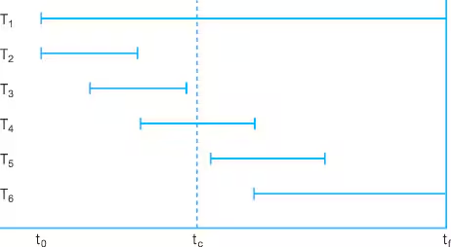
Logging and Rollbacks
Notes:
t_f is failure, t_0 is start time
T_1 – T_6 are transactions. T_1 and T_6 are ongoing at the time of failure. T_2-T_5 have committed before the failure.
Can we ensure that T_2 – T_5 have been flushed to secondary storage before failure? How do we tell the status?

Slide 9
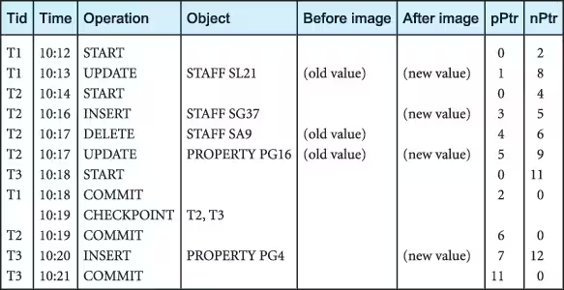
Transaction Logs
Notes:
Compare the secondary storage values to the values in the logs. If the logs match, then we’re up to date, otherwise, we may need to roll forward or rollback based on the transaction commit status.

Slide 10
But what about the log itself?
Deferred Update
Immediate Update
When a transaction starts, write a transaction start record to the log.
On any write, write to the log
On transaction commit, write the commit log. Then flush all changes from the log to the database
If a transaction aborts, ignore the log records for the transaction and do not perform the writes.
When a transaction starts, write a transaction start to the log
On any write, write to the log, then to the database.
When transaction commits, write the commit log.
If a transaction aborts, we must roll-back.
Notes:
The log itself also needs to be written to durable storage. So what do we do?
Deferred update – we can use the logs to recover the database at any point. If changes are idempotent (as they should be), then any updates will be correct. Only need to roll-forward in this case.
Immediate update – we can use the logs to recover the database at any point. However, we must determine which transactions must be rolled-back and which ones must be rolled-forward.

Slide 11
Failure Exercise

Slide 12
Backup and Recovery

Slide 13
Backup and Recovery
Types of backup:
Physical
Logical
Where should they be backed up?
3-2-1 principle
3 copies
2 on different mediums
1+ off-site

Slide 14
Backup examples
Primary / Secondary or Hot / Warm / Cold systems
Using mysqldump to dump the CREATE TABLE and INSERT INTO statements
Use rsync or similar file tools to copy the actual files
Use a full and incremental strategy
MySQL :: MySQL 8.0 Reference Manual :: 9.2 Database Backup Methods
Notes:
MySQL uses “replication” to mirror the existing database to another live database

Slide 15
WPR1 Review

